Slide 1
SMART HEALTH MONITORING SYSTEM USING IOT
Submitted in the partial fulfillment for the award of the degree of
BACHELOR OF ENGINEERING
IN
COMPUTER SCIENCE AND ENGINEERING (INTERNET OF THINGS)
Submitted by:
RAJ GODARA (20BCS4503)
GURLEEN KAUR (20BCS4526)
VARDAN BALIYAN (20BCS4561)
ANNU (20BCS4608)
Under the Supervision of:
MR.GAURAV SONI
(E9610)
Department of AIT-CSE
DISCOVER . LEARN . EMPOWER

Slide 2
OUTLINE
Introduction to Project
Requirements
Problem Formulation
Objectives of the work
Methodology Used
Results & Outputs
Conclusion
Future Scope
References

Slide 3
INTRODUCTION TO PROJECT
The increasing prevalence of lifestyle-related health issues and chronic diseases has highlighted the critical importance of continuous monitoring of vital signs for early detection and proactive management of various health conditions. However, traditional methods of health monitoring often face challenges such as inconvenience, limited accessibility, lack of continuous real-time monitoring, and a reactive approach that focuses on treating symptoms rather than prevention.
To address these limitations, the Smart Health Monitoring System using IoT aims to revolutionize personal healthcare monitoring by leveraging the power of Internet of Things (IoT) technologies. The project's key objectives are to develop a cost-effective and user-friendly solution for remote vital sign monitoring, continuously tracking body temperature, heart rate (BPM), and humidity levels.

Slide 4
INTRODUCTION TO PROJECT
By integrating IoT technologies, the system enables wireless data transmission and secure cloud storage, while offering a user-friendly mobile application for real-time visualization of health data.
Furthermore, the Smart Health Monitoring System incorporates personalized features like customizable profiles, alerts, and historical data tracking, empowering individuals to take an active role in managing their well-being. Through the seamless integration of low-cost hardware, cloud computing, and mobile technology, this system paves the way for a proactive and collaborative approach to personalized healthcare, supporting informed decision-making by both individuals and healthcare professionals.

Slide 5
REQUIREMENTS
Hardware components: Arduino, ESP8266 NodeMCU, Heart Rate Pulse Sensor Module, DHT11 Temperature and Humidity Sensor.
Software requirements: Arduino IDE, Android Studio(Java), Firebase.
Internet connectivity.

Slide 6
PROBLEM FORMULATION
In today's fast-paced world, the prevalence of lifestyle-related health issues and chronic diseases has increased significantly. Monitoring vital signs such as body temperature, heart rate, and humidity levels plays a crucial role in early detection and proactive management of various health conditions. However, traditional methods of monitoring these parameters often face several challenges:
1. Inconvenience: Frequent hospital visits or the use of expensive medical equipment can be inconvenient and inaccessible for many individuals, especially those with mobility issues or living in remote areas.
2. Lack of continuous monitoring: Traditional methods typically provide snapshots of vital signs at specific intervals, failing to capture real-time fluctuations or patterns that could be indicative of potential health problems.
3. Limited accessibility: Access to medical professionals and healthcare facilities may be limited, particularly in rural or underserved areas, hindering timely monitoring and intervention.
4. Reactive approach: Traditional healthcare models often focus on treating symptoms rather than proactively monitoring and preventing health issues, resulting in higher healthcare costs and potentially poorer outcomes.

Slide 7
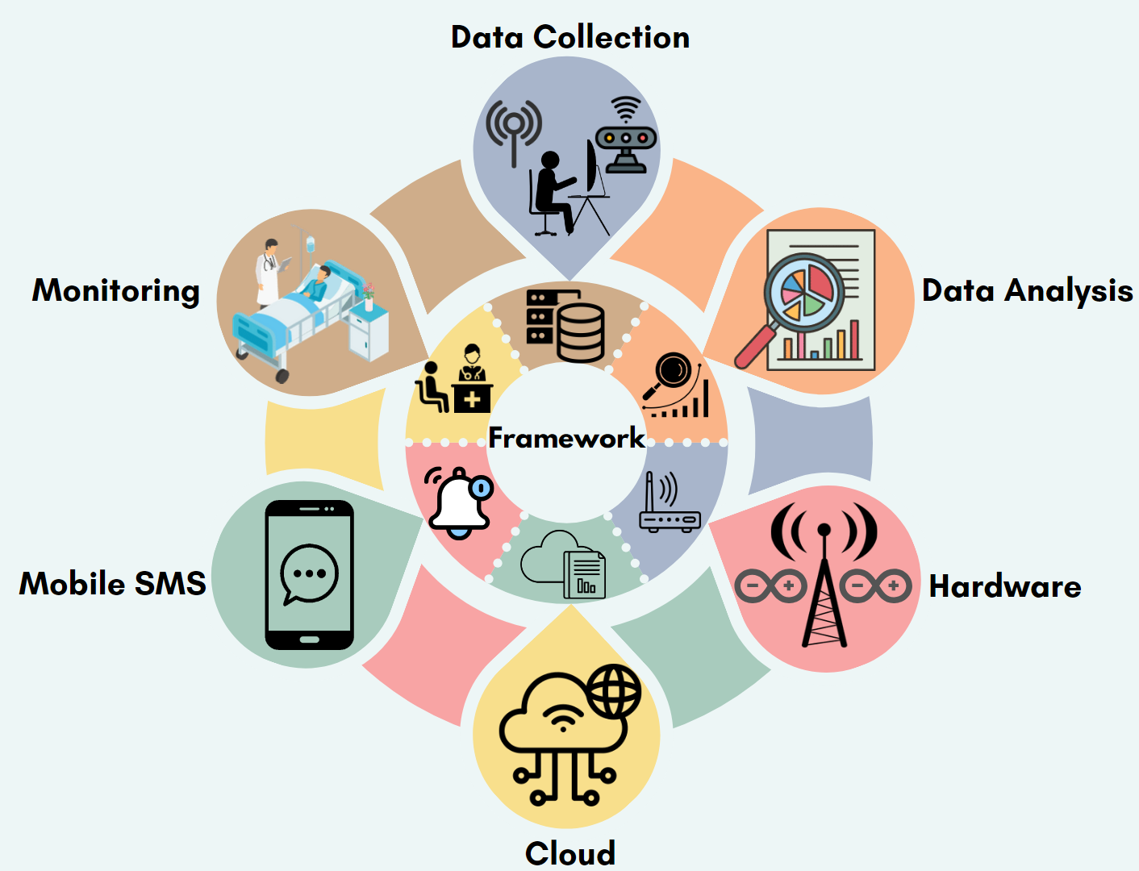
PROBLEM FORMULATION
The Smart Health Monitoring System using IoT aims to address these challenges by providing a cost-effective, user-friendly, and continuous remote monitoring solution for vital signs, empowering individuals to take an active role in managing their well-being while supporting healthcare professionals in delivering informed and timely care.

Slide 8
OBJECTIVES OF THE WORK
Integrate multiple sensors, including pulse rate, heart rate pulse sensors, and temperature sensors to capture vital body data such as heart rate, temperature, humidity.
Transmit the collected data to the cloud for storage and analysis.
Develop a mobile application to provide users with real-time access to their vital body data.
Utilize the gathered data to predict potential medical conditions related to the heart, thereby enabling proactive healthcare management.

Slide 9
METHODOLOGY USED
Sensor data acquisition and integration with Arduino: Utilize heart rate pulse rate and temperature pressure sensors for data acquisition. Integrate the sensors with Arduino for data processing and transmission.
Cloud platform selection and setup: Selection of a suitable cloud platform for data storage and analysis. Set up the chosen cloud platform to ensure secure and reliable data transmission.
Mobile app development: Develop a mobile application for data visualization and user interface. Ensure the app can securely retrieve and display the health data from the cloud.
Analysis and implementation: Implementing in real time to analyze the acquired data for predicting heart-related medical conditions.

Slide 10
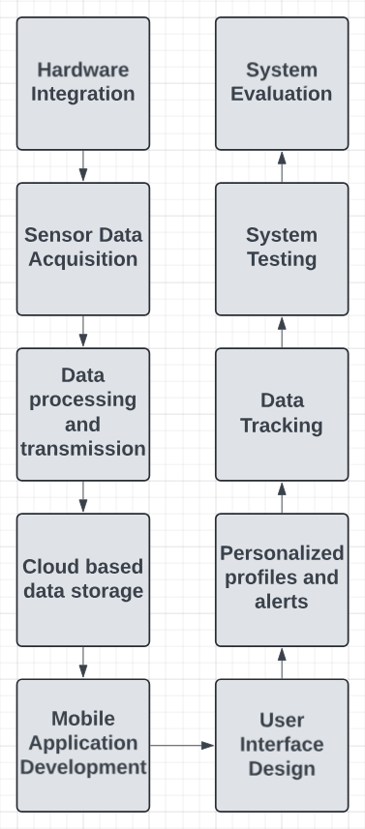
METHODOLOGY USED

Slide 11
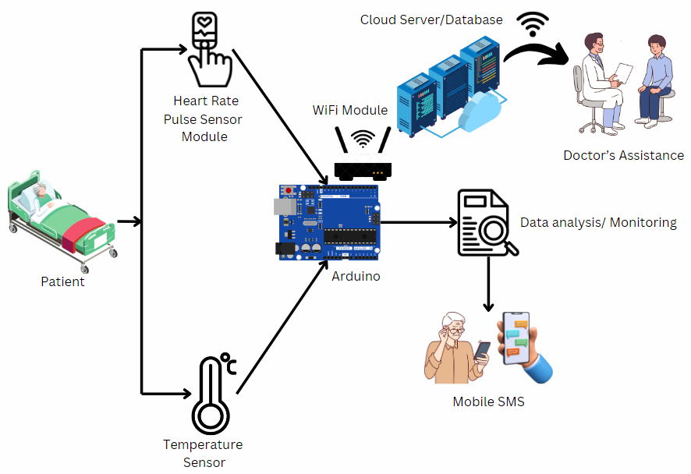
METHODOLOGY USED

Slide 12
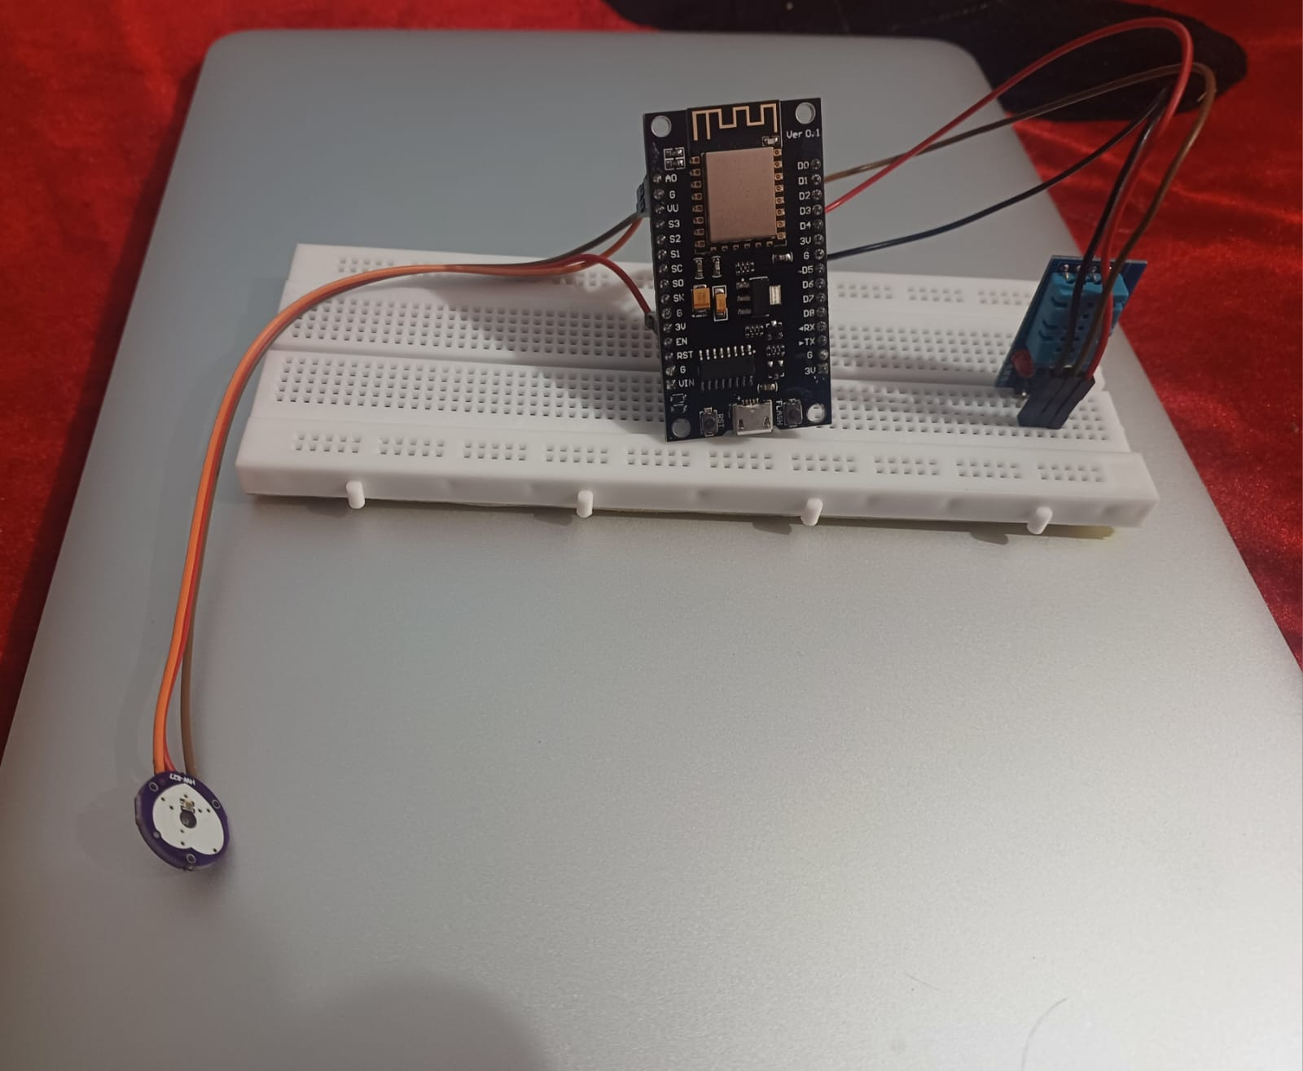
RESULTS

Slide 13
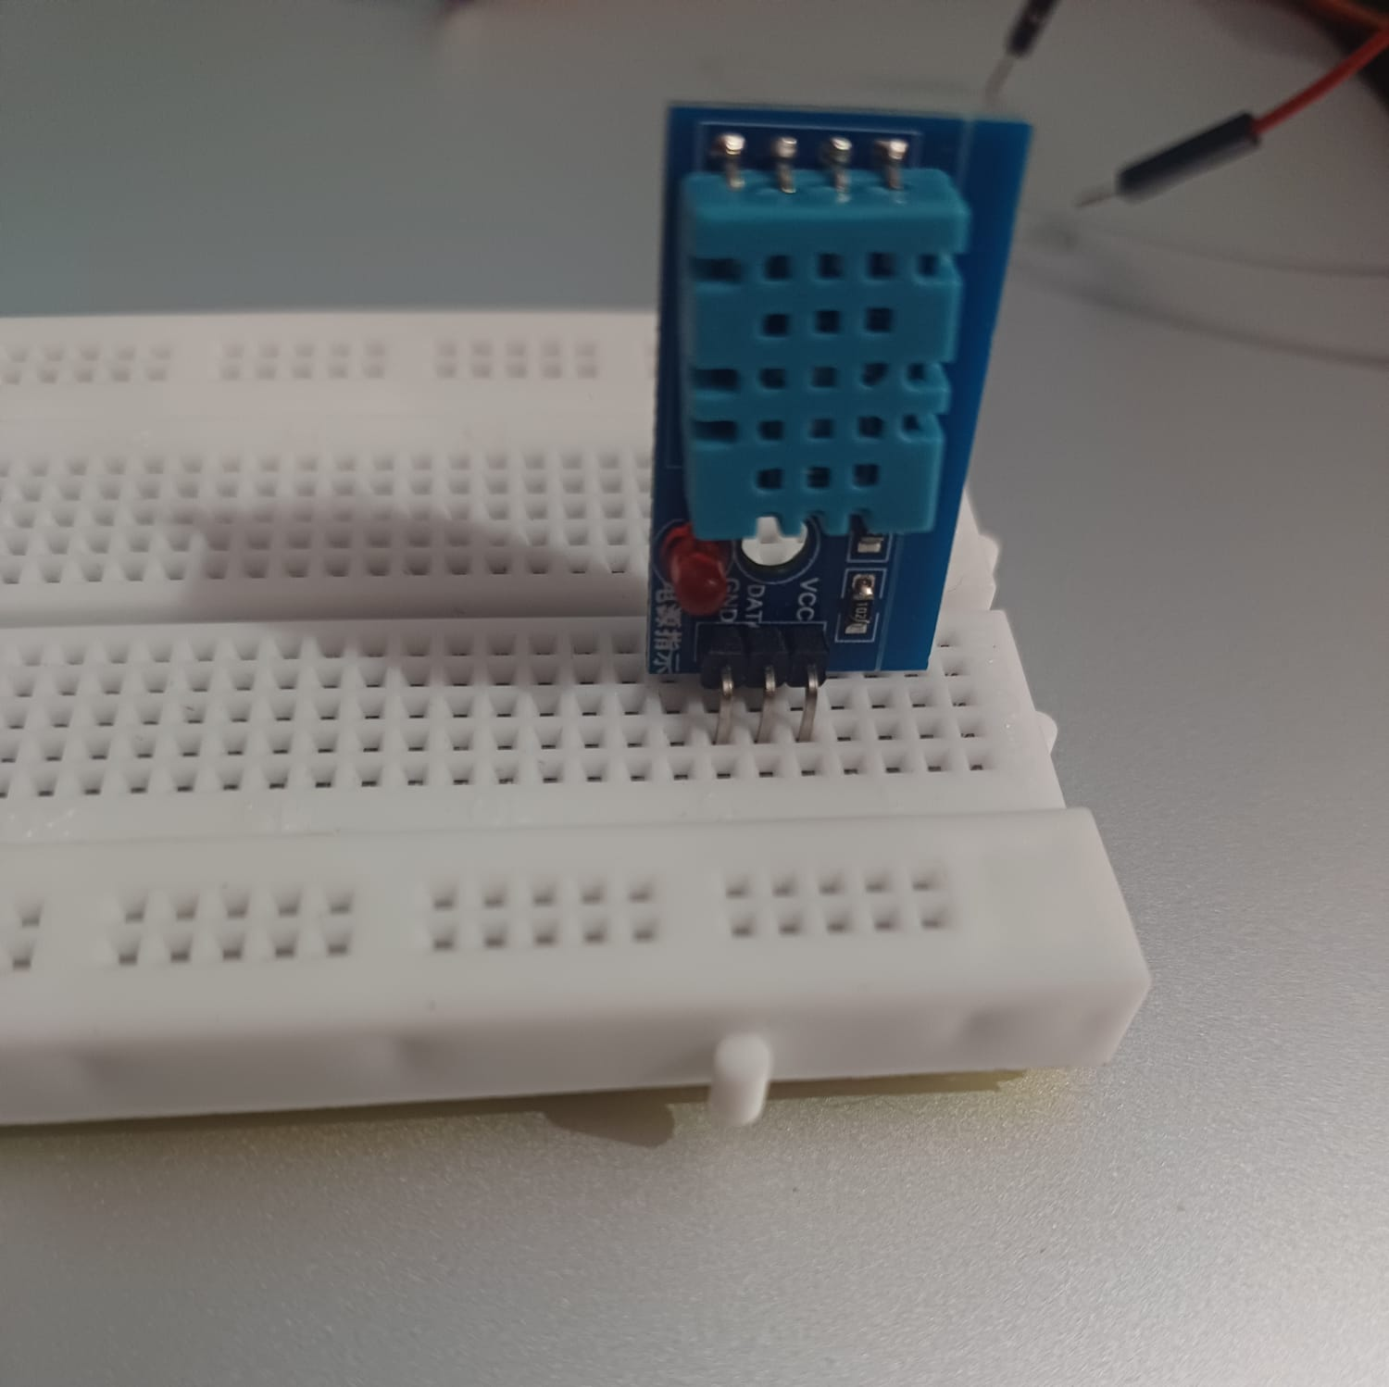
RESULTS

Slide 14
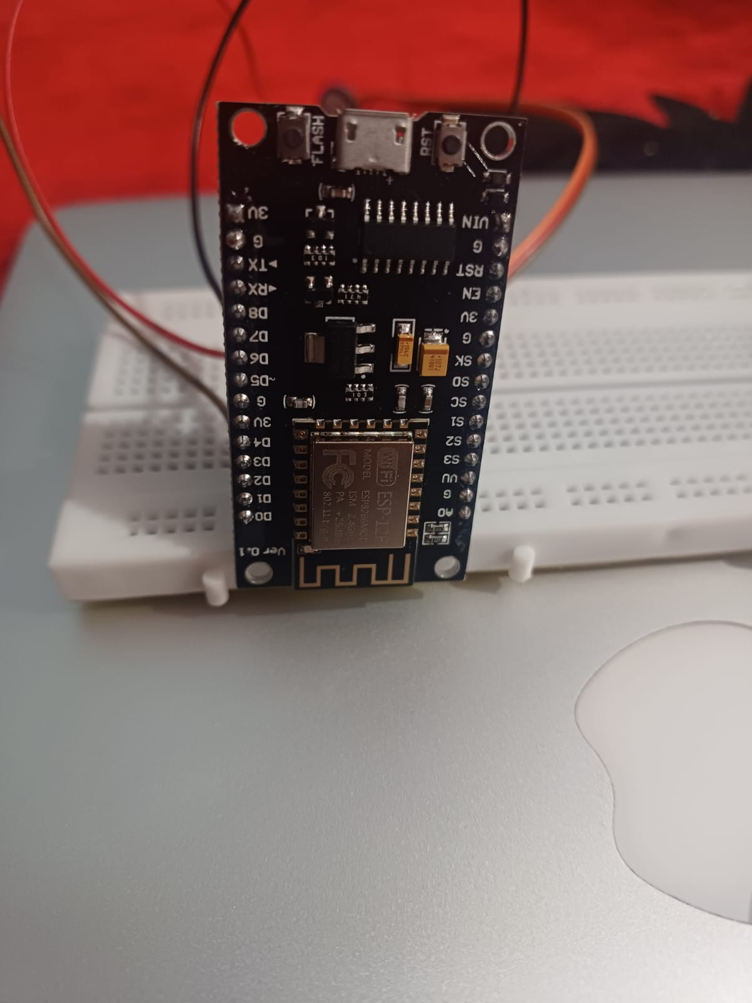
RESULTS

Slide 15
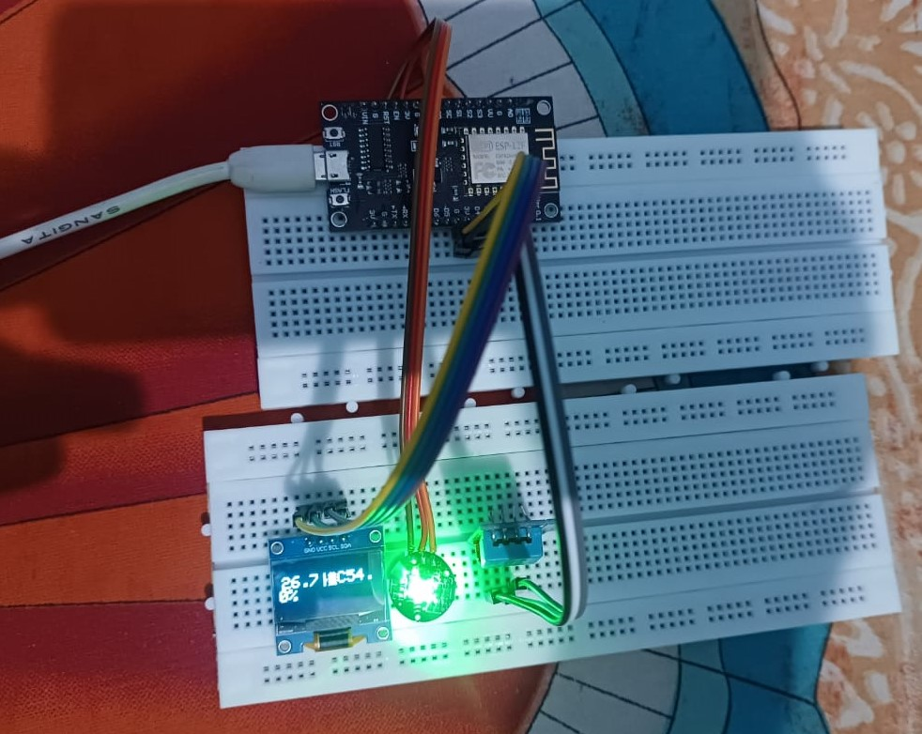
RESULTS

Slide 16
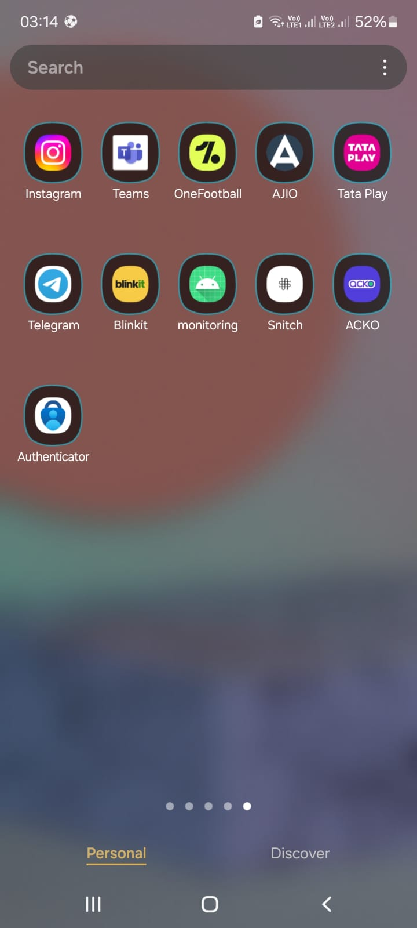
RESULTS

Slide 17
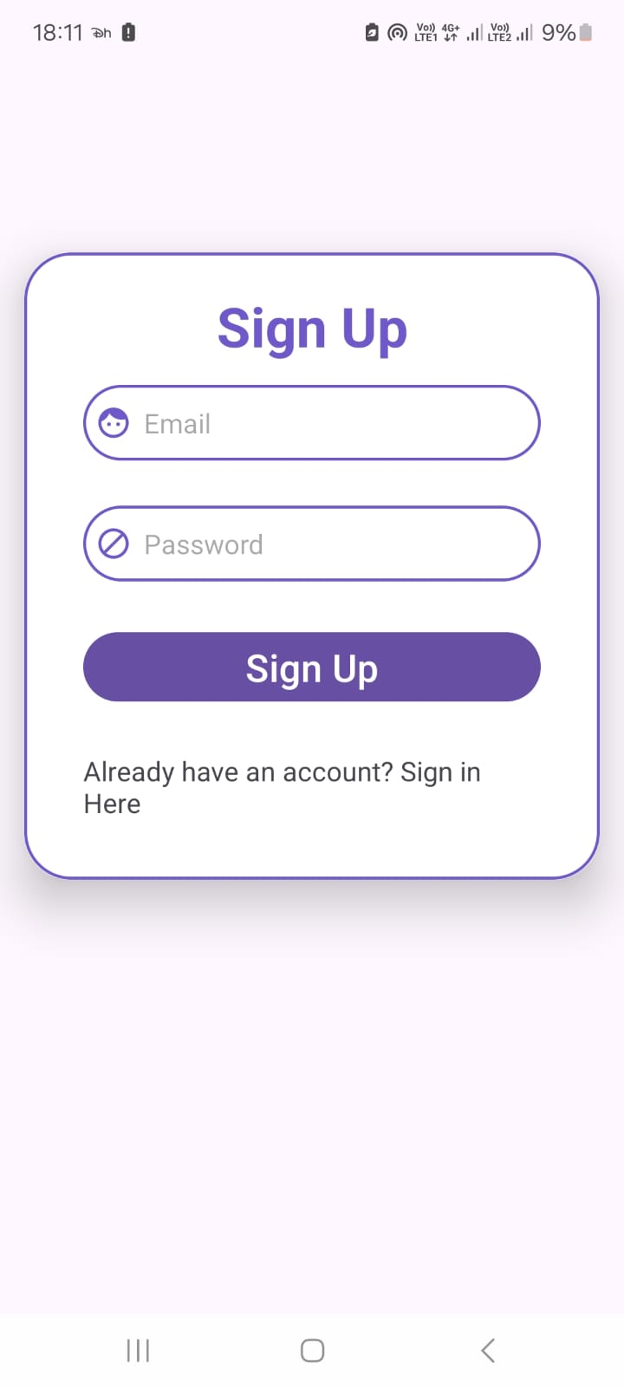
RESULTS

Slide 18
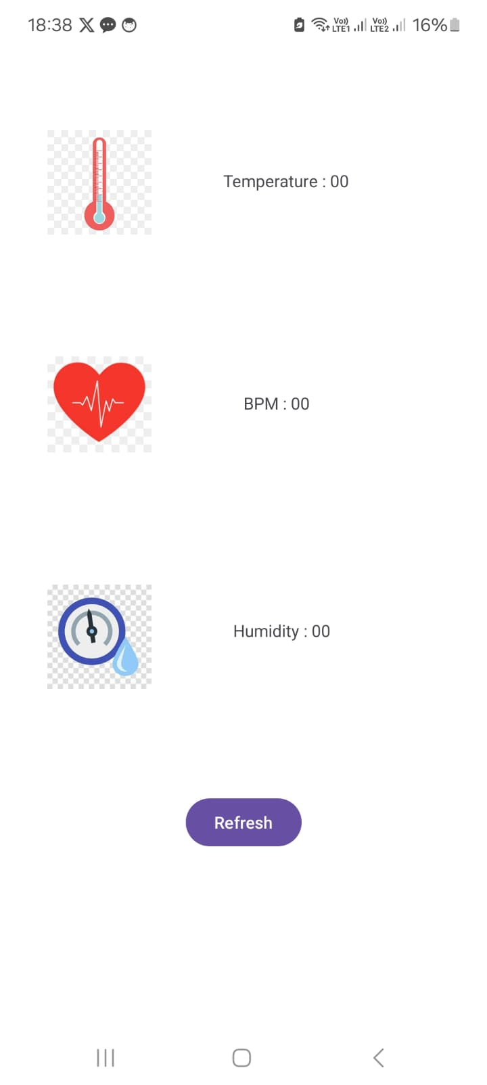
RESULTS

Slide 19

RESULTS

Slide 20
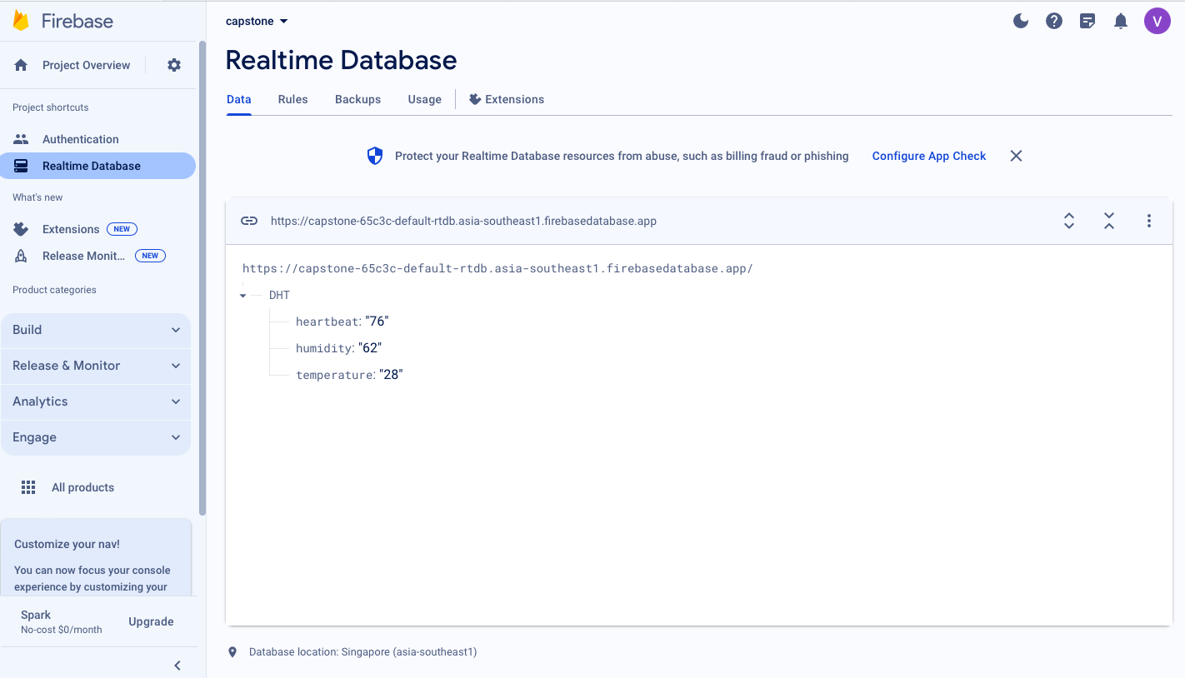
RESULTS

Slide 21
CONCLUSION
In conclusion, the Smart Health Monitoring System leverages the power of Internet of Things technologies to revolutionize personal healthcare monitoring. By seamlessly integrating low-cost hardware components, wireless data transmission, secure cloud storage, and a user-friendly Android application, the system addresses the limitations of traditional health monitoring methods. It provides continuous remote monitoring of vital signs like temperature, heart rate, and humidity levels, enabling early detection and proactive management of health issues. With personalized features such as customizable profiles, alerts, and historical data tracking, the system empowers individuals to take an active role in managing their well-being. Furthermore, the system's potential for future enhancements, including integration of additional sensors, machine learning capabilities, wearable device integration, and interoperability with electronic health record systems, paves the way for a comprehensive and collaborative approach to personalized healthcare.

Slide 22
FUTURE SCOPE
Integration of additional sensors for BP monitoring, oxygen saturation level tracking, glucose level monitoring, etc.
Wearable device integration like smartwatches, fitness trackers.
Enhanced security and privacy measures.
Implementation of machine learning approaches for data analysis, predictive analysis, predictive modeling.

Slide 23
REFERENCES
Mohan, Madhan & Pichandi, Sathya. (2019). Smart Health Monitoring System through IOT.
Valsalan, Prajoona & Tariq, Ahmed & Hussain, Ali. (2020). IOT BASED HEALTH MONITORING SYSTEM. 2020. 10.31838/jcr.07.04.137.
Khan, Tarannum & Chattopadhyay, Manju. (2017). Smart health monitoring system. 1-6. 10.1109/ICOMICON.2017.8279142.
Abdulmalek, Suliman & bin, Abdul Nasir & Al-Areeqi, Waheb & Almuhaya, Mukarram & Bairagi, Anupam & Khan, Md. Al-Masrur & Kee, Seong-Hoon. (2022). IoT-Based Healthcare-Monitoring System towards Improving Quality of Life: A Review. 10.3390/healthcare10101993.
Khan, Mohammad & Alanazi, Turki & Albraikan, Amani & Almalki, Faris. (2022). IoT-Based Health Monitoring System Development and Analysis. Security and Communication Networks. 2022. 1-11. 10.1155/2022/9639195.
Gajare, Mansi & Dani, Manas & Deshmukh, Payal & Chaudhari, Pritesh. (2021). IOT based Health Monitoring System.
Sultana, Salma & Rahman, Sadia & Rahman, Md & Chakraborty, Narayan & Hasan, Tanveer. (2021). An IoT Based Integrated Health Monitoring System. 549-554. 10.1109/ICCCA52192.2021.9666412.

Slide 24
REFERENCES
Sekhar, Y. Ravi. "Android based health care monitoring system." Department Of ECE, Vignan's University, Vadlamudi, India.
D. A. M. Budida and R. S. Mangrulkar, "Design and implementation of smart HealthCare system using IoT," 2017 International Conference on Innovations in Information, Embedded and Communication Systems (ICIIECS), Coimbatore, India, 2017, pp. 1-7, doi: 10.1109/ICIIECS.2017.8275903.
H. Al-Hamadi and I. R. Chen, "Trust-Based Decision Making for Health IoT Systems," in IEEE Internet of Things Journal, vol. 4, no. 5, pp. 1408-1419, Oct. 2017, doi: 10.1109/JIOT.2017.2736446.
Rahaman, A., Islam, M.M., Islam, M.R., Sadi, M.S., Nooruddin, S. (2019). Developing IoT based smart health monitoring systems: A review. Revue d'Intelligence Artificielle, Vol. 33, No. 6, pp. 435-440. https://doi.org/10.18280/ria.330605
Joyia, G.J., Liaqat, R.M., Farooq, A. and Rehman, S., 2017. Internet of medical things (IoMT): Applications, benefits and future challenges in healthcare domain. J. Commun., 12(4), pp.240-247.
S. M. R. Islam, D. Kwak, M. H. Kabir, M. Hossain and K. -S. Kwak, "The Internet of Things for Health Care: A Comprehensive Survey," in IEEE Access, vol. 3, pp. 678-708, 2015, doi: 10.1109/ACCESS.2015.2437951.

Slide 25
REFERENCES
K. Perumal, M. Manohar, A Survey on Internet of Things: Case Studies, Applications, and Future Directions, In Internet of Things: Novel Advances and Envisioned Applications, Springer International Publishing, (2017) 281-297.
Islam, M.M., Rahaman, A. & Islam, M.R. Development of Smart Healthcare Monitoring System in IoT Environment. SN COMPUT. SCI. 1, 185 (2020). https://doi.org/10.1007/s42979-020-00195-y
Azzawi, Mustafa & Hassan, Rosilah & Abu Bakar, Khairul Azmi. (2016). A Review on Internet of Things (IoT) in Healthcare. International Journal of Applied Engineering Research. 11. 10216-10221.
Shubham Banka, Isha Madan and S.S. Saranya, Smart Healthcare Monitoring using IoT. International Journal of Applied Engineering Research ISSN 0973-4562 Volume 13, Number 15, pp. 11984-11989, 2018. 4.
Ennafiri, Mohamed & Mazri, Tomader. (2020). INTERNET OF THINGS FOR SMART HEALTHCARE: A REVIEW ON A POTENTIAL IOT BASED SYSTEM AND TECHNOLOGIES TO CONTROL COVID-19 PANDEMIC. ISPRS - International Archives of the Photogrammetry, Remote Sensing and Spatial Information Sciences. XLIV-4/W3-2020. 219-225. 10.5194/isprs-archives-XLIV-4-W3-2020-219-2020.
M. Hummady, Muna & Fadhil, Heba. (2023). Smart Healthcare Medical Bracelet using the Internet of Things. 10.1109/ICCA56443.2022.10039622.

Slide 26


